Slide 1
Configuring Permissions
29 August 2011
Notes:
Permissions - <number>
Guidewire training materials contain Guidewire proprietary information that is subject to confidentiality and non-disclosure agreements. You agree to use the information in this manual solely for the purpose of training to implement Guidewire software solutions. You also agree not to disclose the information in this manual to third parties or copy this manual without prior written consent from Guidewire. Guidewire training may be given only by Guidewire employees or certified Guidewire partners under the appropriate agreement with Guidewire.

Slide 2
Lesson objectives
By the end of this lesson, you should be able to:
  Describe the ClaimCenter functionality that enforces security
  Create system permissions
  Write Gosu expressions that evaluate user permissions
  Use application permission keys
  This lesson uses the notes section for additional explanation and information.
  To view the notes in PowerPoint, choose View→Normal or View→Notes Page.
  If you choose to print the notes for the lesson, be sure to select “Print hidden slides.”
Notes:
Permissions - <number>

Slide 3
Lesson outline
ClaimCenter security functionality
  Permissions
  Roles
  ACLs
  Security dictionary
Checking system permissions in Gosu
Creating system permissions
Application permission keys
Notes:
Permissions - <number>

Slide 4
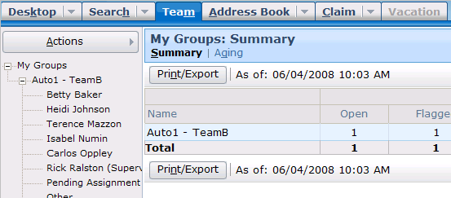
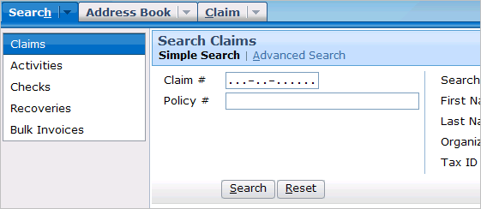
Access
Ida
Belt
Rick
Ralston
Access is the ability to see and do things within ClaimCenter based on your user identity
ClaimCenter has a rich set of access functionality that is managed through a set of permissions
Notes:
Permissions - <number>
This lesson discusses how your ability to do something can vary based on who you are as a user. It does not discuss your ability to do things based on where you are in a business process. (For example, in the base application, you cannot manually add an activity to a claim during the new claim wizard, but you can do this after the claim has been saved. This restriction is true for all users and stems from the requirements of the business process. This type of restricted access is not the focus of this lesson.)

Slide 5
System permissions
View claims
View groups
View Desktop
Edit claims
Edit groups
Own claims
A system permission is a granular ability to see or do something within ClaimCenter
Notes:
Permissions - <number>
In the example above, the system permissions have been arranged in columns based on the thing the permission pertains to. The second column has only two permissions because you cannot own a group. The third column has only one permission because it pertains to an aspect of the ClaimCenter user interface. The Desktop cannot be edited or owned.
Some system permissions pertain to abilities outside of the web browser (such as the ability to run Guidewire Studio - the application used to modify business rules). However, there is only a small number of these permissions and they fall outside of the scope of this course. Consequently, this lesson does not discuss them.
System permissions are often referred to simply as "permissions".
The entire list of system permissions can be seen in the Security Dictionary. This is discussed later in this lesson.

Slide 6
How permissions can influence access
Whether or not a user has a given permission can determine what they can:
  View/navigate to
  Create, edit, and/or delete
  Own
  Act on
Notes:
Permissions - <number>
The list of abilities in the slide above is meant as a general way of viewing of permissions and not an official categorization. There are some permissions which map directly to one of the words listed above. For example, there are "view claims" and "view matters" permissions. Other permissions map less directly to the words listed above. For example, there is a "validate claims" permission and a "void payments" permission, both of which can be thought of as "act on" permissions.
All permissions change the user experience in one of two ways:
A permission could control whether an aspect of the user interface is visible for not. (For example, users who do not have the View Desktop permission simply don't see the Desktop tab, whereas users who do have this permission do see the tab.)
A permission could control whether or not a user succeeds or fails at a given task. (For example, if a user attempts to assign a claim to a user who does not have the "own claim" permission, the assignment fails. If a user attempts to assign a claim to a user who does have the "own claim" permission, the assignment succeeds.)

Slide 7
View/navigate to permissions
Ida
Belt
View Team
Rick Ralston
View Team
Notes:
Permissions - <number>
In the example above:
Ida Belt is a CSR without the View Team permission. When Ida logs on, she cannot see the Team tab.
Rick Ralston is a manager with the View Team permission. When Rick logs on, he can see the Team tab.

Slide 8

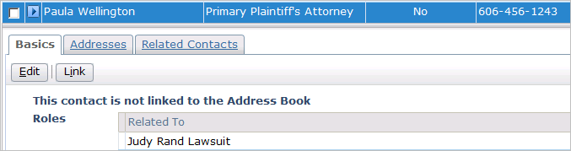
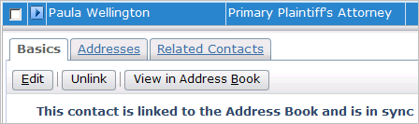
Create object permissions
Betty Baker
Create Address Book Contacts
Rick
Ralston
Create Address Book Contacts
Notes:
Permissions - <number>
In the example above:
Betty Baker is an adjuster without the Create Address Book Contacts permission. When she attempts to link a contact to the address book, the system searches for a match. It cannot find one, and it is unable to create a new one because she lacks the permission to do this.
Rick Ralston is a manager with the Create Address Book Contacts permission. When he attempts to link a contact to the address book, the system searches for a match. It cannot find one, but it is able to create a new one because he has the permission to do this.

Slide 9


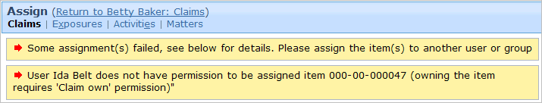


Own object permissions
Ida
Belt
Own Claim
Carlos Oppley
Own Claim
Notes:
Permissions - <number>
In the example above:
Ida Belt is a CSR without the Own Claim permission. When someone attempts to assign a claim to Ida, the system prevents the assignment and informs the user that Ida lacks the permission needed to own a claim.
Carlos Oppley is an adjuster with the Own Claim permission. When someone attempts to assign a claim to Carlos, he becomes the owner of the claim.

Slide 10
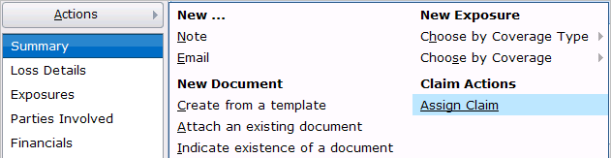
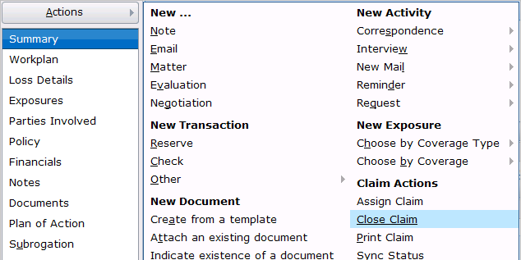
Act on permissions
Ida
Belt
Close Claim
Betty Baker
Close Claim
Notes:
Permissions - <number>
In the example above:
Ida Belt is a CSR without the Close Claim permission. Her Claim Actions menu lacks the Close Claim menu item.
Carlos Oppley is an adjuster with the Close Claim permission. His Claim Actions menu has the Close Claim menu item.

Slide 11
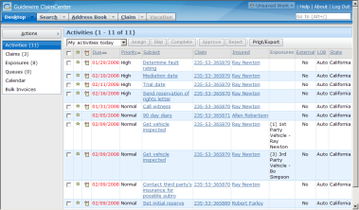

A user's permissions are determined during login
username
and password
Desktop: Activities
authenticated?
what permissions?
which start page?
Yes!
View claim, ...
Desktop: Activities
cc
data
Notes:
Permissions - <number>
When an end user attempts to log on to an application, the following occurs:
The user supplies their user name and password to ClaimCenter via the login page.
ClaimCenter queries its database to authenticate the user and determine which permissions are assigned to the user and what the user's start page is. Out-of-box, authentication is managed through the ClaimCenter database. There is a table in the database which stores user names and password. (The system can also be configured to authenticate against an existing user domain structure.) Permissions determine which screens the user can navigate to and which actions the user can perform. The startup view is the first page rendered after log in.
ClaimCenter authenticates the user.
ClaimCenter renders the appropriate startup view with permissions appropriate for that user.

Slide 12
Lesson outline
ClaimCenter security functionality
  Permissions
  Roles
  ACLs
  Security dictionary
Checking system permissions in Gosu
Creating system permissions
Application permission keys
Notes:
Permissions - <number>

Slide 13
Roles
CSR
Adjuster
View claims
Create claims
Edit claims
Edit exposures
...
View claims
View confidential Notes
Create claims
Own claims
Edit claims
Edit exposures
Edit matters
...
A role is a named collection of permissions used to simplify the assignment of permissions to users
  Typically maps to job title or job function
Notes:
Permissions - <number>
There are no absolute rules regarding how the permission/role structure must be built to accommodate users with varying levels of access. For example, if adjusters should be able to do everything CSRs can do as well as some adjuster-only tasks, then:
You could create the Adjuster role so it has all the permissions of the CSR role plus the additional permissions. CSR users get just the CSR role. Adjuster users get just the adjuster role.
You could create the Adjuster role so it has only the additional permissions that CSRs do not get. CSR users get just the CSR role. Adjusters get both the CSR and the adjuster role.

Slide 14
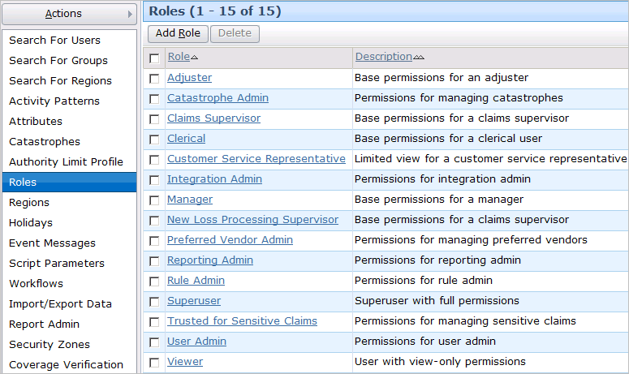
Managing roles
Accessing the Roles list view requires the "Manage Roles" permission, which is typically given only to high-level supervisors
Notes:
Permissions - <number>

Slide 15
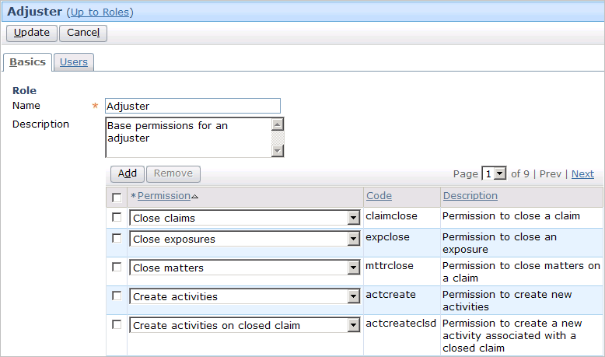
Modifying permissions in a role
Notes:
Permissions - <number>
To add a permission to a role:
Navigate to the role.
Click the Edit button in the screen toolbar.
Click the Add button in the permissions list view toolbar.
In the new row, select the desired permission from the dropdown.
Click Update.
To remove a permission from a role:
Navigate to the role.
Click the Edit button in the screen toolbar.
Select the permission row to delete.
Click the Remove button in the permissions list view toolbar.
Click Update.

Slide 16
Mapping roles to users
Ida Belt
Betty Baker
Rick Ralston
CSR
Adjuster
Adjuster
Manager
Each user is given one or more roles
  A user has all the permissions of the roles s/he is given
Notes:
Permissions - <number>
In the example above:
Ida Belt is a CSR, and therefore has all the permissions of a CSR through the CSR role.
Betty Baker is an adjuster, and therefore has all the permissions of a adjuster through the Adjuster role.
Rick Ralston is a manager, and therefore has all the permissions of a manager. To accomplish this, he has both the Adjuster role and the Manager role. (Presumably, the Manager role does not contain all permissions normally associated to an adjuster.)
ClaimCenter permissions only give you the ability to do something. Unlike the permission structure of some other systems, ClaimCenter does not have any permissions that specifically deny a person the ability to do something. The only way to prevent someone from having a given permission is to not assign them any roles that have that permission.

Slide 17
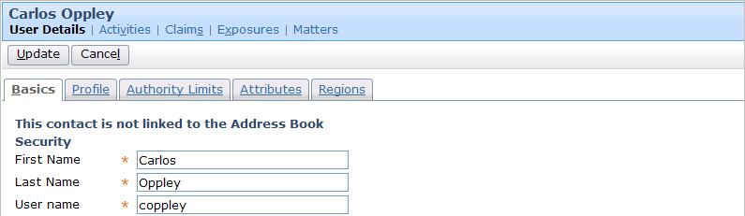
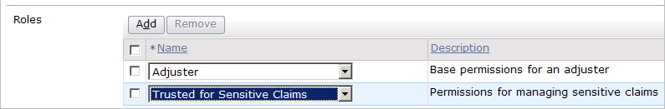
Modifying roles for a user
A user can be given one or many roles using the Roles list in the user detail view
Notes:
Permissions - <number>
To grant a role to a user:
Navigate to the user.
Click the Edit button in the screen toolbar.
Click the Add button in the roles list view toolbar.
In the new row, select the desired role from the dropdown.
Click Update.
To revoke a role from a user:
Navigate to the user.
Click the Edit button in the screen toolbar.
Select the role row to delete.
Click the Remove button in the role list view toolbar.
Click Update.
Modifying a user's roles requires the "Grant roles to users" permission, which is typically given to managers.

Slide 18
Lesson outline
ClaimCenter security functionality
  Permissions
  Roles
  ACLs
  Security dictionary
Checking system permissions in Gosu
Creating system permissions
Application permission keys
Notes:
Permissions - <number>

Slide 19
Access control lists (ACLs)
Claim 100-00-100001
ACL
Users on this ACL:
- Dana Evans
- Peter Beebe
- Ida Belt
...
An access control list (ACL) is a list associated to a claim that identifies the users who can access the claim and its sub-objects
  ACLs ensure that given user can view or edit only objects which he or she has need to view or edit
Notes:
Permissions - <number>
(This material will be a review if you have already taken the ClaimCenter Introduction course.)
The primary purpose of the Access Control List feature is to enforce the business requirement that any given user should be able to work on some of the claims in the system, but no user at or below the manager level should be able to work on or even view all of the claims within the system. ACLs are a mechanism for specifying the logic used to determine which claims a user can edit and which claims a user can view.
ACLs are also used to determine who can own a given type of claim.

Slide 20
Permissions and ACLs work together
Dana
Evans
View Claim
Claim 100-00-100001
ACL
Jason
Tran
View Claim
Users on this ACL:
- Dana Evans
- Peter Beebe
- Ida Belt
...
Ida
Belt
Notes:
Permissions - <number>
(This material will be a review if you have already taken the ClaimCenter Introduction course.)
In order to view or act on a claim, a user must have the appropriate permission as well as appear on the claim's ACL. In the example above:
Dana Evans has the view claim system permission and is allowed to view claims on the ACL for 100-00-100001. Therefore, Dana Evans can view claim 100-00-100001.
Jason Tran has the view claim system permission, but he is not listed on the ACL for 100-00-100001. Therefore, he cannot view claim 100-00-100001. (Presumably, he is on the ACL for other claims and can view those claims.)
Ida Belt is listed on the ACL for 100-00-100001 as someone who can view the claim. However, she does not have the view claim system permission. Therefore, she cannot view claim 100-00-100001. (In fact, in the scenario described above, Ida Belt cannot view any claim regardless of what the ACLs for the claims say.)

Slide 21
Static and object-based permissions
Static permissions are granted or denied across entire application
Object-based permissions are granted or denied on claim-by-claim basis
  These permissions are ACL-related
Create Group
Create Exposure
(for given claim)
Notes:
Permissions - <number>
An example of a static permission is "Create Group". A user with this permission can create groups without restriction.
An example of an object-based permission is "Create Exposure". A user with this permission cannot create exposures on any claim, but rather only claims the user has access to.
In ClaimCenter, all object-based claims are really claim-based. The term object-based is generic and used in all of the Guidewire products.

Slide 22
Lesson outline
ClaimCenter security functionality
  Permissions
  Roles
  ACLs
  Security dictionary
Checking system permissions in Gosu
Creating system permissions
Application permission keys
Notes:
Permissions - <number>

Slide 23
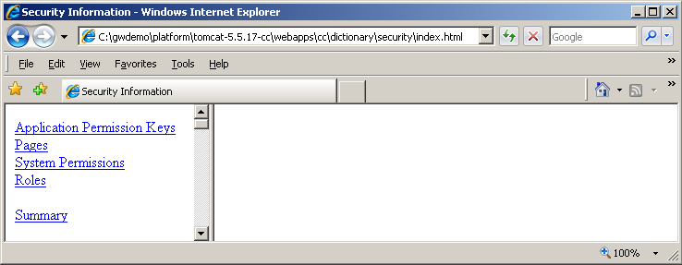

The security dictionary
Series of HTML pages that document permissions and roles in your application
  The dictionary has four main sections
Notes:
Permissions - <number>
The security dictionary is located at: <server directory>\build\dictionary\security\index.html. The security dictionary will reflect the initial relationship between permissions and roles. No changes to these relationships will be reflected in the security dictionary, even if it is rebuilt.
The security dictionary lists four types of information:
Application Permission Keys
Pages (in the user interface)
System Permissions
Roles
An application permission key is a set of one or more system permissions. ClaimCenter defines application permission keys internally as a method for improving system performance. For example, the claimedit permission key represents the system permissions for the editing a claim: claimedit for open claims and claimeditclsd for closed claims. Application permission keys appear in the files used to specify the user interface, so it is important for consultants to know what they are. However, you cannot create or modify application permission keys.
The Application Permission Keys section of the security dictionary lists each application permission key, the set of system permissions it contains, and the pages and elements in the user interface that reference the application permission key.
The Pages section of the security dictionary lists each page in the user interface and the permissions needed to view or edit that page (if any).
The System Permissions section and Roles section are discussed on the next slides.

Slide 24
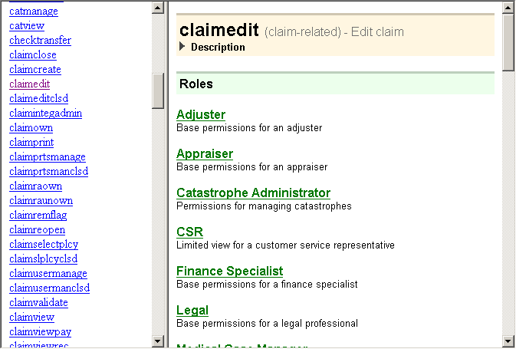

System permissions in the security dictionary
static or object-based?
Notes:
Permissions - <number>
The System Permissions section of the security dictionary lists each permission (alphabetically by internal code) and for each permission the roles that contain it, the application permission keys that contain it, and the pages and user interface elements that reference it.

Slide 25
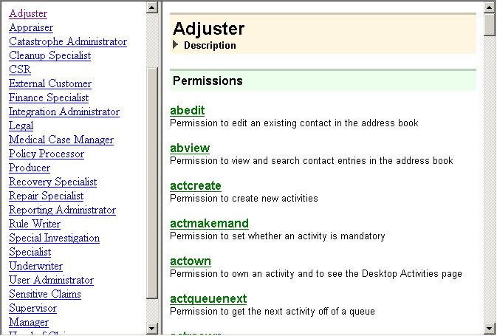
Roles in the security dictionary
Notes:
Permissions - <number>
The Roles section of the security dictionary lists each role and the permissions it contains.
Keep in mind that the security dictionary is a series of static HTML pages based on xml files, so no changes to the Roles made by an administrator will be visible in the Security Dictionary, even after it has been regenerated.

Slide 26
Lesson outline
ClaimCenter security functionality
Checking system permissions in Gosu
Creating system permissions
Application permission keys
Notes:
Permissions - <number>

Slide 27
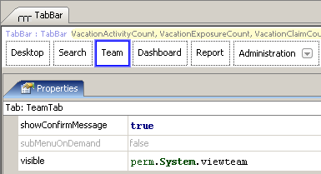

The perm namespace
"perm" is a Gosu namespace used to create expressions that evaluate if current user has given permission
  Expression returns true or false
Notes:
Permissions - <number>
In the example above, the visible expression checks to see if the user has the viewteam permission. If he or she does, then the Team tab is visible. Otherwise, it is not.
Note that we are checking for permissions, not roles.
There is a method available on the current user called hasRole() – it is possible to have editable/visible/etc test if the user has this role. This is not a good approach for these reasons:
1. You would have to give someone the role or take it away to give access to a field. The problem with this is that a role likely has many other associated permissions that you would not want to be granting (or taking away.) You could of course have a role with a single permission, but then you are losing the entire value proposition that the role provides.
2. If you add hasrole() as the check on a field, any requirements changes such as the desire to allow a new role to have this power would require an upgrade to the UI since every field with the hasRole() check would need to be updated, as opposed to simply having an admin add a permission to the new role.

Slide 28
Typical uses of perm expressions
Atomic widget attributes
  Control visibility, editability, or availability of a field, button, or menu item
Container widget attributes
  Control visibility or editability of a detail view or list view
Location attributes
  Control ability to visit or edit a location
Business rules
  Modify rule behavior (such as generating additional activity if current user lacks a given permission)
Notes:
Permissions - <number>

Slide 29

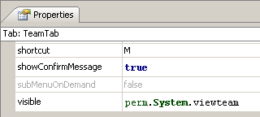

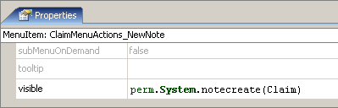
perm syntax: System permissions
Static permissions:
perm.System.permission
  Returns true if current user
  has the named permission
Object-based permissions: perm.System.permission(claim)
  Returns true if current user
  has the named
  permission on the
  named claim
Notes:
Permissions - <number>
In the first example, the Team tab is visible if the user has the viewteam system permission.
In the second example, the New Note menu item is visible if the user has the notecreate system permission for this claim (as determined by the claim's access control list).

Slide 30
Lesson outline
ClaimCenter security functionality
Checking system permissions in Gosu
Creating system permissions
Application permission keys
Notes:
Permissions - <number>

Slide 31
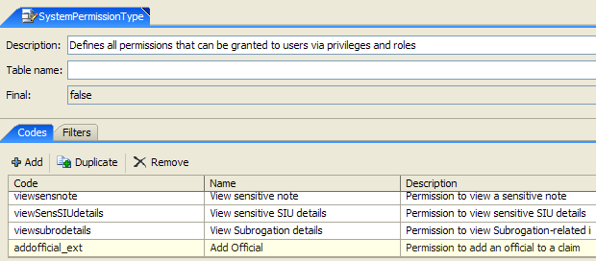
SystemPermissionType typelist
Add typecodes to create new static permissions
Notes:
Permissions - <number>
System permissions are defined in the SystemPermissionType typelist.
You cannot create new object-based system permissions.

Slide 32
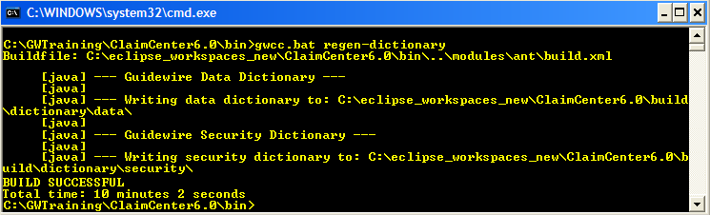
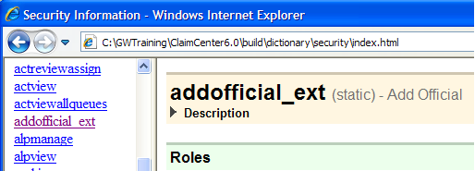
New permissions in the security dictionary
You must regenerate dictionaries to see new permissions listed within security dictionary
  gwcc.bat regen-dictionary
Notes:
Permissions - <number>
Remember that you cannot regenerate the security dictionary to update the role-permission relationships, since those changes are not reflected in xml files.

Slide 33
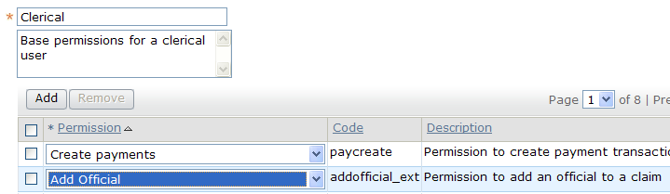
New permissions in application
Once deployed, new permissions can be added to roles
Notes:
Permissions - <number>

Slide 34

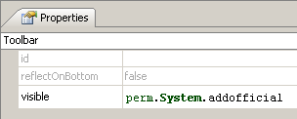

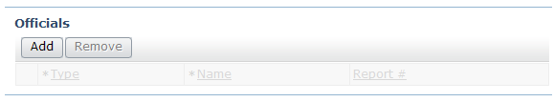
Example: Adding perm expression to UI
User without addofficial_ext...
User with addofficial_ext...
Notes:
Permissions - <number>
In the example above, the visible condition for the toolbar checks to see if the user has the addofficial_ext system permission. If the user does not, then the toolbar is not visible.

Slide 35
Review: Adding new system permission
Add new permission to SystemPermissionType typelist
  Regen-dictionary (optional)
  Restart server
Add new permission to role from Administration tab in ClaimCenter
Add perm expression in PCF or code to alter behavior based on whether user has this new permission
  Reload PCFs into UI
Notes:
Permissions - <number>

Slide 36
Lesson outline
ClaimCenter security functionality
Checking system permissions in Gosu
Creating system permissions
Application permission keys
Notes:
Permissions - <number>

Slide 37
Application permission keys
Claim Edit
Create claim
Edit claim
Edit
claim
true
Create claim
Edit
closed claim
false
An application permission key is a system-defined group of one or more permissions
  Improves performance when evaluating user permission
  If given user has any permission in group, returns true
Notes:
Permissions - <number>
An application permission key is a set of one or more system permissions. ClaimCenter defines application permission keys internally as a method for improving system performance. For example, the Claim edit application permission key represents the system permissions for the editing a claim: claimedit for open claims and claimeditclsd for closed claims. Application permission keys appear in the files used to specify the user interface, so it is important for developers to know what they are. However, you cannot create or modify application permission keys.
You cannot create or modify application permission keys. Each has been created specifically to optimize permissions evaluation.

Slide 38
Static and object-based permissions
Static keys return true or false based solely on whether user has any permission in key
Object-based keys return true or false based on whether user has any permission in key for given object
Group Edit
Edit groups
Claim Edit
Edit claim
Edit closed claim
Notes:
Permissions - <number>
An example of a static application permission key is "Group Edit". This key returns true for any user with the "Edit Groups" permission.
An example of a object-based application permission key is "Claim Edit". This key returns true for any user who has "Edit claim" or "Edit closed claim" for a given claim. If the user lacks both of these permissions, or if the user has both of these permissions but does not have them for the given object, then the key returns false.
In the security dictionary, permissions are listed as static or "object-based".

Slide 39
Application permission key entities
Group
Claim
Group Edit
Claim Edit
Edit groups
Edit claim
Edit closed claim
Every application permission key is associated to given entity
  Given entity is listed at beginning of key name
Notes:
Permissions - <number>

Slide 40
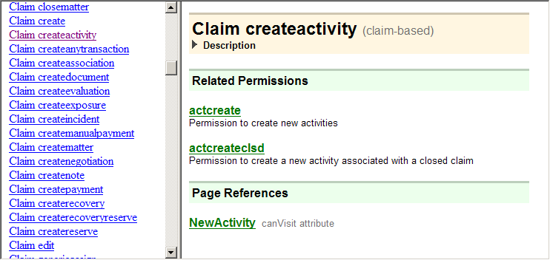

Application permission keys in the security dictionary
static or object-based?
Notes:
Permissions - <number>
The Application Permission Keys section of the security dictionary lists each application permission key, the set of system permissions it contains, and the pages and elements in the user interface that reference the application permission key.
In the security dictionary, permissions are listed as static or "object-based".

Slide 41

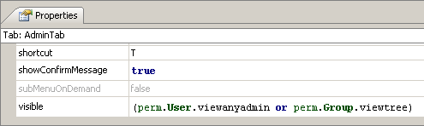
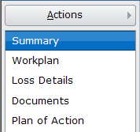
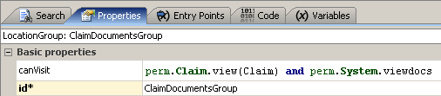
perm syntax: Key permissions
Static keys: perm.entity.appKey
  Returns true if
  current user
  has any
  permission in
  given key
Object-based keys: perm.entity.appKey(object)
  Returns true if current user has any
  permission
  in given
  key on the
  named
  object
Notes:
Permissions - <number>
The entity argument is the entity to which the application permission key is defined. For example, the syntax to check for the "Group Edit" application permission key is perm.Group.edit.
In the first example, the Administration tab is visible if the user has any permission in the viewanyadmin application permission key (which includes userview, groupview, attrview, regionview, catview, integadmin, roleview, actpatview, scrprmview, alpview, grouptreeview, reporting_admin, covverifyview, and wcrefview) or any permission in the viewtree application permission key (which includes grouptreeview).
In the second example, the Documents location group can be visited (and is therefore visible) if the user has any permission in the Claim's view application permission key, the user is on the ACL for this claim, and the user has the static viewdocs system permission. If any of those three tests do not evaluate to true, then the user cannot visit this location group.

Slide 42
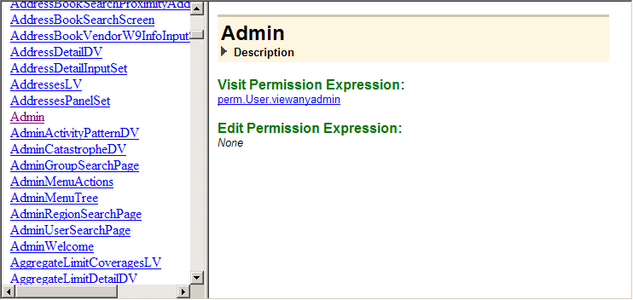
Pages in the security dictionary
Lists conditions that check either system permission or application permission keys
Notes:
Permissions - <number>
The Pages section of the security dictionary lists each location and container in the user interface (alphabetically by name) and for each the perm conditions associated to it.

Slide 43
Lesson objectives review
You should now be able to:
  Describe the ClaimCenter functionality that enforces security
  Create system permissions
  Write Gosu expressions that evaluate user permissions
  Use application permission keys
Notes:
Permissions - <number>

Slide 44
Review questions
What is the difference between:
  A static permission and an object-based permission?
  A permission and an application permission key with only one permission in it?
  An application permission key with two permissions (such as "create note" and "edit note") and a role with the same two permissions?
Given the following perm condition:
perm.System.applyCheck
  Is applyCheck a system permission or an application permission key?
  Is applyCheck static or object-based?
Notes:
Permissions - <number>
Answers
1. a) A static permission is one that is granted or revoked for the entire application. An object-based permission is granted on a claim-by-claim basis.
b) Possible answers:
A permission can be created by a developer. An application permission key cannot.
A permission can be added to a role. An application permission key cannot.
A permissions check using an application permission key will execute faster than a permissions check which directly references a permission.
c) Possible answers:
An application permission key is created to optimize permissions checks. A role is created to assign permissions to users.
Developers can create and modify roles. Developers cannot create and modify application permission keys.
2. a) It is a system permission. Perm statements for system permissions start with "perm.System". Perm statements for application permission keys start with "perm.<entityName>".
b) It is static. Object-based permissions would include a "(Claim)" argument.

Slide 45
Notices
Copyright © 2001-2011 Guidewire Software, Inc. All Rights Reserved.
Guidewire, Guidewire Software, Guidewire ClaimCenter, Guidewire PolicyCenter, Guidewire BillingCenter, Guidewire Reinsurance Management, Guidewire ContactManager, Guidewire Vendor Data Management, Guidewire Client Data Management, Guidewire InsuranceSuite, Guidewire ContactCenter, Guidewire Studio, Gosu, Deliver Insurance Your Way, and the Guidewire logo are trademarks or registered trademarks of Guidewire Software, Inc. in the United States and/or other countries.
This material is Guidewire proprietary and confidential. The contents of this material, including product architecture details and APIs, are considered confidential and are fully protected by customer licensing confidentiality agreements and signed Non-Disclosure Agreements (NDAs).
This file and the contents herein are the property of Guidewire Software, Inc. Use of this course material is restricted to students officially registered in this specific Guidewire-instructed course, or for other use expressly authorized by Guidewire. Replication or distribution of this course material in electronic, paper, or other format is prohibited without express permission from Guidewire.
    Guidewire products are protected by one or more of the following patents: U.S. Patent No. 7,885,831; U.S. Patent No. 7,788,296.
Notes:
Introduction to Guidewire Configuration - <number>

